Slide 1
Installation of Virtual Box and Ubuntu
Ubuntu 24.04 LTS in VirtualBox
https://www.youtube.com/watch?v=Hva8lsV2nTk

Slide 2
pwd
What is the ‘pwd’ Command?
The ‘pwd’ command stands for “print working directory.”
It’s a fundamental command in Unix-like operating systems used to display the current working directory — the directory you are currently in.

Slide 3
The Simplest Form
At its most basic, you can use ‘pwd’ without any options:
pwd
This will display the absolute path of the current working directory.
For example:
/home/username

Slide 4
Common Options
-L: Display the logical current working directory
pwd -L
This shows the path as you navigated it, including any symbolic links.
-P: Display the physical current working directory (resolving symbolic links)
pwd -P
This shows the actual physical path, resolving any symbolic links to their real locations.

Slide 5
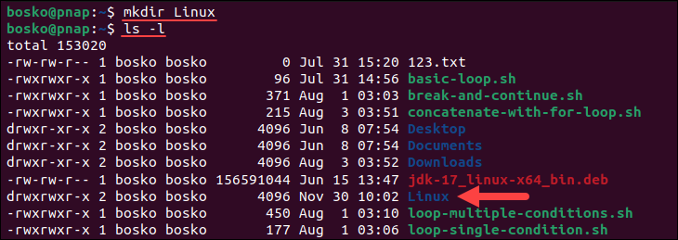
Create a Directory in Linux via mkdir
To create a directory using the terminal, pass the desired directory name to the mkdir
mkdir [options] dir_name
Eg: mkdir Linux
If the operation is successful, the terminal returns an empty line.
To verify the directory's creation, use the ls command:
ls -l

Slide 6
Create Directory in Specific Location
To create a directory or directories in a specific location other than your current working directory, specify the full directory path.
For example:
mkdir /Linux/example
The command creates a directory example in the specified location.
To verify, change to Linux folder and use ls command
ls -l

Slide 7
Create Multiple Directories
While it is possible to create directories one by one with mkdir, it can be time-consuming when you need to create more than a few.
To avoid that, run a single directory names separated by a space.
Eg: mkdir dir1 dir2 dir3
You can also use with curly brackets to create multiple directories.
For example, to create several directories, list them within curly brackets, without spaces:
mkdir {test1,test2,test3}

Slide 8
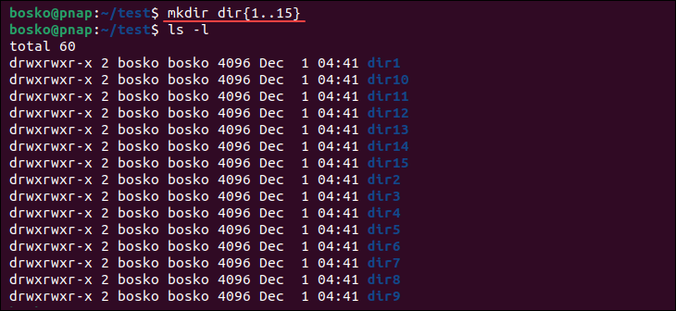
Create Multiple Directories
You can also create a batch of directories starting with the same pattern. Prepend the curly brackets with the pattern and use the brackets to specify the number of directories. For example:
mkdir dir{1..15}
The command above creates 15 directories, from dir1 to dir15.

Slide 9
How to Make Parent Directories
Building a structure with multiple subdirectories using mkdir requires adding the –p option.
This ensures that mkdir adds any missing parent directories in the process.
mkdir –p Linux/dirtest1/dirtest2

Slide 10
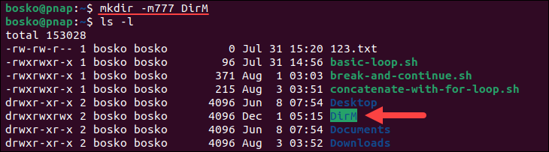
How to Set Permissions When Making a Directory
The mkdir command gives rwx (read, write, and execute) permissions for the current user only by default.
To add all the permissions for all users, specify the –m option with the user 777 when creating a directory.
Eg: Run the following command to create a directory DirM with rwx permissions:
mkdir –m777 DirM

Slide 11
How to Verify Directories?
When executing mkdir commands, there is no feedback for successful operations.
To see the details of the mkdir process, append the –v option to the command.
By getting the feedback from the process, you do not have to run the ls command to verify directory was created.

